Slide 1
Dijkstra ‘Algorithm’ {
Dijkstra.py
Made_with_pycharm.mainpy
[Single Source Shortest Path]
< By Abdelrahman Nader >
}

Slide 2
‘Index’ {
01
02
03
Dijkstra.py
Made_with_pycharm.mainpy
Introduction
Implementation
Visualization
}

Slide 3
01 {
[Introduction]
Dijkstra.py
Made_with_pycharm.mainpy
}

Slide 4
Problem Definition; {
Dijkstra.py
Made_with_pycharm.mainpy
<p The Single Source Shortest Path problem focuses on finding the shortest path from the source to every node in a weighted graph. While this can be solved by many algorithms, we will be focusing on Dijkstra’s algorithm.
>
</p>
}

Slide 5
Strategy; {
Dijkstra.py
Made_with_pycharm.mainpy
<p The approach we are going to use is the Greedy approach which as the name implies searches for the best current option. This is its biggest advantage and disadvantage as it may disregard the optimal solution for immediate gains depending on the problem >
</p>
}

Slide 6
Applications; {
Dijkstra.py
Made_with_pycharm.mainpy
<p Many real life problems can be tackled with this algorithm such as finding the shortest route between two points. Whether it’s the distance between two points on a Map (google maps) or finding the shortest route to each node in IP routing the algorithm has proven to work astoundingly >
</p>
}

Slide 7
02 {
[Implementation]
Dijkstra.py
Made_with_pycharm.mainpy
}

Slide 8
Following the Strategy; {
Dijkstra.py
Made_with_pycharm.mainpy
<p First of all, lets think about the problem. We have N nodes that represent a graph and we need to get to the end in the least cost possible. To do that we will take the currently available path with the least cost ahead of us and if the if the path to the current node is less than the previous cost update it >
</p>
}

Slide 9
Implementation;
Dijkstra.py
Made_with_pycharm.mainpy
def Dijkstra(self, src): pq = PriorityQueue() prev = [[]] * self.N pq.put((0, src)) dist = [float("inf")] * self.N # Make the value of all priorities infinite (lowest possible priority) dist[src] = 0 # Make the priority of the start node 0 (highest possible priority) path = [[]] * self.N for i in range(self.N): d, u = pq.get() # Pop the node with the least value (highest priority) for v, weight in self.adj[u]: # Check all adjacent nodes for the current node if dist[v] > dist[u] + weight: # Ignore paths bigger than current path dist[v] = dist[u] + weight # Update path with smaller value prev[v] = u pq.put((dist[v], v)) # add node to queue
Step 01
Step 02
Step 03
Step 04

Slide 10
Implementation ‘(cont.)’ {
Dijkstra.py
Made_with_pycharm.mainpy
Step 01
First, as mentioned before we always need the least cost available to do that we can utilize the priority queue which as the value lessens the priority rises.
Step 02
We will loop V times since each Node will be visited one time only
Step 03
We pop the node with highest priority
Step 04
Iterate over the neighbors and check if the current cost of the neighbor is more than the cost to the current node plus the cost of movement. If yes then change the neighbor cost to the current plus the cost and push the neighbor to the queue.
}

Slide 11
Data-Structures Used; {
Dijkstra.py
Made_with_pycharm.mainpy
<p There are different ways to realize this algorithm although all share the same general structure. In my implementation I will be representing the graph with an undirected adjacency list, additionally I will be using a priority queue(python’s priority queue utilizes the min-heap) to queue the nodes yet to be explored. Lastly I will use a list to save the values of least cost for each node with each value except the start initialized as infinity >
</p>
}

Slide 12
03 {
[Visualization]
Dijkstra.py
Made_with_pycharm.mainpy
}

Slide 13
Settings
Made_with_pycharm.mainpy
Light Mode; {

Slide 14
Settings
Made_with_pycharm.mainpy
Light Mode; {

Slide 15
Dijkstra.py
Made_with_pycharm.mainpy
Visualization; {
1
4
2
3
2
5
6
[Visualization]
0
7
3
4
4
}
Queue: (0,cost:0)
min-cost: 0/ inf / inf / inf / inf

Slide 16
Dijkstra.py
Made_with_pycharm.mainpy
Visualization; {
1
2
3
0
7
3
4
}
Queue: (1,cost:3),(3,cost:7)
min-cost: 0/ 3 / inf / 7 / inf

Slide 17
Visualization; {
Dijkstra.py
Made_with_pycharm.mainpy
1
2
3
0
7
3
4
}
Queue: (1,cost:3),(3,cost:7)
min-cost: 0/ 3 / inf / 7 / inf

Slide 18
Visualization; {
Dijkstra.py
Made_with_pycharm.mainpy
1
4
2
3
2
5
6
0
7
3
4
4
}
Queue: (3,cost:7)
min-cost: 0/ 3 / 7 / 5 / inf

Slide 19
Visualization; {
Dijkstra.py
Made_with_pycharm.mainpy
1
4
2
3
2
0
3
4
}
Queue: (3,cost:5),(2,cost:7),(3,cost:7)
min-cost: 0/ 3 / 7 / 5 / inf

Slide 20
Visualization; {
Dijkstra.py
Made_with_pycharm.mainpy
1
4
2
3
2
0
3
4
}
Queue: (3,cost:5),(2,cost:7),(3,cost:7)
min-cost: 0/ 3 / 7 / 5 / inf

Slide 21
Visualization; {
Dijkstra.py
Made_with_pycharm.mainpy
1
4
2
3
2
5
6
0
7
3
4
4
}
Queue: (2,cost:7),(3,cost:7)
min-cost: 0/ 3 / 7 / 5 / 9

Slide 22
Visualization; {
Dijkstra.py
Made_with_pycharm.mainpy
1
2
2
5
0
7
3
4
4
}
Queue: (2,cost:7),(3,cost:7),(4,cost:9),(2,cost:10)
min-cost: 0/ 3 / 7 / 5 / 9

Slide 23
Visualization; {
Dijkstra.py
Made_with_pycharm.mainpy
1
4
2
3
2
0
3
4
}
Queue: (2,cost:7),(3,cost:7),(4,cost:9),(2,cost:10)
min-cost: 0/ 3 / 7 / 5 / inf

Slide 24
Visualization; {
Dijkstra.py
Made_with_pycharm.mainpy
1
2
2
5
0
7
3
4
4
}
Queue: (2,cost:7),(3,cost:7),(4,cost:9),(2,cost:10)
min-cost: 0/ 3 / 7 / 5 / 9

Slide 25
Visualization; {
Dijkstra.py
Made_with_pycharm.mainpy
1
2
2
5
6
0
7
3
4
4
}
Queue: (3,cost:7),(4,cost:9),(2,cost:10)
min-cost: 0/ 3 / 7 / 5 / 9

Slide 26
Visualization; {
Dijkstra.py
Made_with_pycharm.mainpy
1
4
2
3
2
5
6
0
7
3
4
4
}
Queue: (4,cost:9),(2,cost:10)
min-cost: 0/ 3 / 7 / 5 / 9

Slide 27
Visualization; {
Dijkstra.py
Made_with_pycharm.mainpy
1
2
2
5
0
7
3
4
4
}
Queue:(2,cost:10)
min-cost: 0/ 3 / 7 / 5 / 9

Slide 28
Visualization; {
Dijkstra.py
Made_with_pycharm.mainpy
1
2
2
5
0
7
3
4
4
}
Queue:Complete
min-cost: 0/ 3 / 7 / 5 / 9

Slide 29
The shortest route
the path to node 0 is 0
the path to node 1 is 1<-0
the path to node 2 is 2<1<-0
the path to node 3 is 3<-1<-0
the path to node 4 is 4<-3<-1<-0

Slide 30
Time complexity; {
Dijkstra.py
Made_with_pycharm.mainpy
<p First, let’s start by writing the L.H.S of the equation.
Since we have V the number of vertices and E the max number of a edges
for a node which is (V-1) at most, we can start like this:
T(V,E) =
>
</p>
}

Slide 31
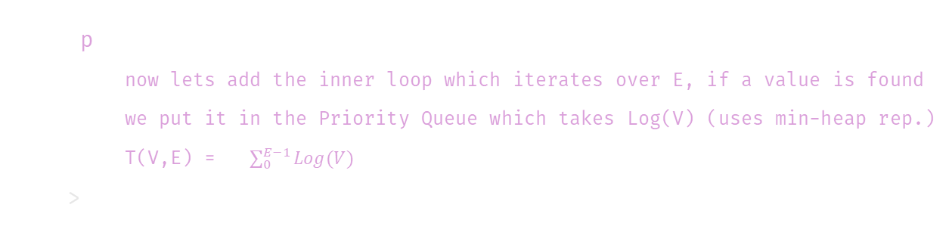
Time complexity; {
Dijkstra.py
Made_with_pycharm.mainpy
<p
now lets add the inner loop which iterates over E, if a value is found
we put it in the Priority Queue which takes Log(V) (uses min-heap rep.)
T(V,E) = $\sum_{0}^{E−1}{Log(V)}$
>
</p>
}

Slide 32
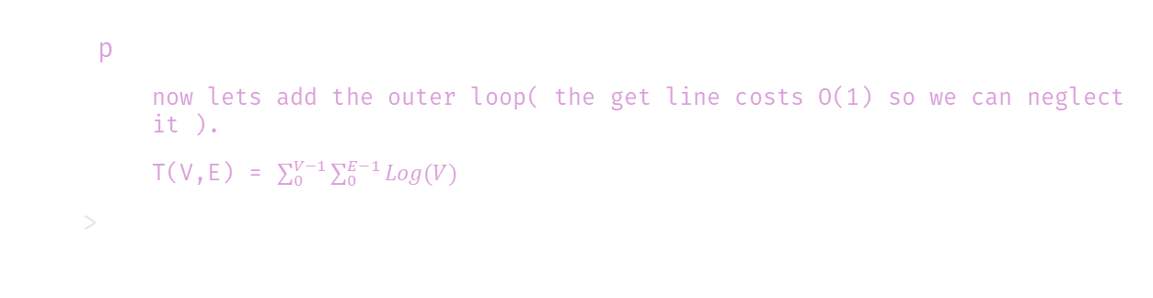
Time complexity; {
Dijkstra.py
Made_with_pycharm.mainpy
<p
now lets add the outer loop( the get line costs O(1) so we can neglect it ).
T(V,E) = $\sum_{0}^{V−1}{\sum_{0}^{E−1}{Log(V)}}$
>
</p>
}

Slide 33
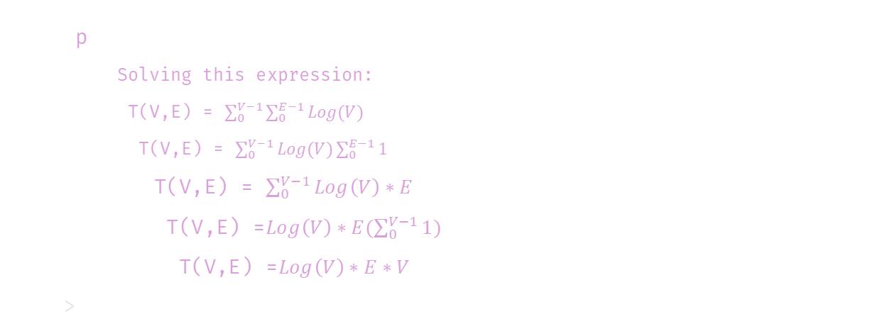
Time complexity; {
Dijkstra.py
Made_with_pycharm.mainpy
<p
Solving this expression:
T(V,E) = $\sum_{0}^{V−1}{\sum_{0}^{E−1}{Log(V)}}$
T(V,E) = $\sum_{0}^{V−1}{Log(V)\sum_{0}^{E−1}{1}}$
T(V,E) = $\sum_{0}^{V−1}{Log\left(V\right)∗E}$
T(V,E) =$Log\left(V\right)∗E(\sum_{0}^{V−1}{1)}$
T(V,E) =$Log\left(V\right)∗E∗V$
>
</p>
}

Slide 34
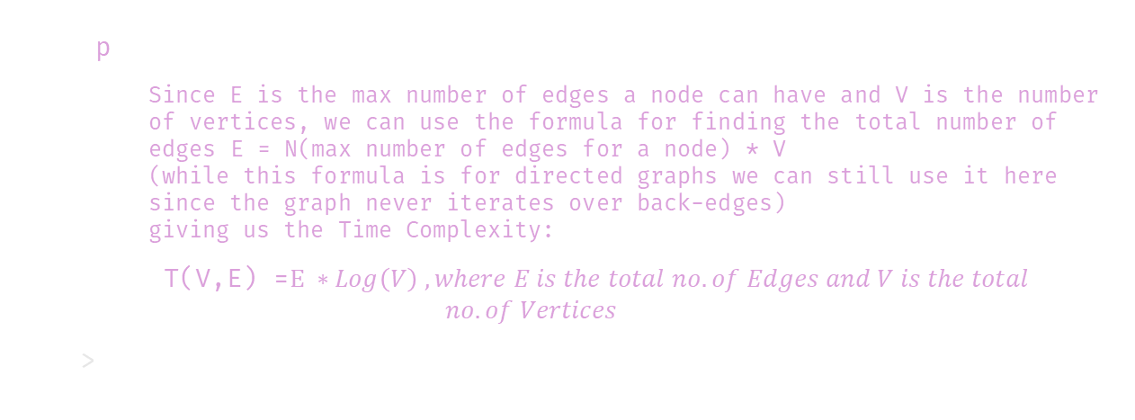
Time complexity; {
Dijkstra.py
Made_with_pycharm.mainpy
<p
Since E is the max number of edges a node can have and V is the number of vertices, we can use the formula for finding the total number of edges E = N(max number of edges for a node) * V (while this formula is for directed graphs we can still use it here since the graph never iterates over back-edges) giving us the Time Complexity:
T(V,E) =$E ∗Log\left(V\right) , where E is the total no. of Edges and V is the total$
$$no. of Vertices$$
>
}
</p>

Slide 35
Dijkstra.py
Made_with_pycharm.mainpy
[]
Thank Yolm;lk;lu

Slide 36
Dijkstra.py
Made_with_pycharm.mainpy
[Thank You]

